Slide 1
Financial Machine Learning
Presentation for Module VII
Introduction to Market Risk Analytics

Slide 2
Variance and Standard Deviation

Slide 3
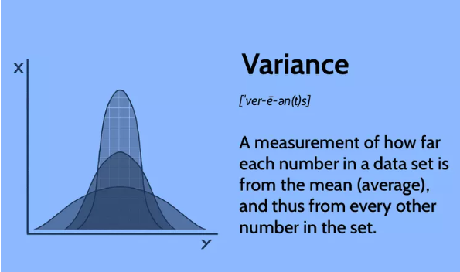
Measures of Variability: Variance
A measure of the dispersion or spread of a set of values in a dataset
It quantifies how much individual data points deviate from the mean (average) of the dataset
Quantify volatility of asset returns and thus is a important tool for risk assessment and understanding the variability of investment returns
Notes:
Image source: https://www.investopedia.com/terms/v/variance.asp
In statistics, "variance" is a measure of the dispersion or spread of a set of values in a dataset. It quantifies how much individual data points deviate from the mean (average) of the dataset. In other words, variance indicates the average of the squared differences between each data point and the mean.
A higher variance indicates that the data points are more spread out from the mean, while a lower variance indicates that the data points are closer to the mean. Variance is an essential tool for understanding the variability and volatility of data.
Mathematically, the population variance (often denoted as "σ²") is calculated as follows:
Population Variance (σ²) = (Sum of Squared Deviations from the Mean) / (Number of Data Points)
For a sample, the sample variance (often denoted as "s²") is calculated as follows:
Sample Variance (s²) = (Sum of Squared Deviations from the Sample Mean) / (Number of Data Points - 1)
Example: Calculating Variance of Investment Returns
Suppose you are a portfolio manager analyzing the monthly returns of a stock over the past six months to assess its volatility and risk. You have the following monthly return data (in percentage):
Monthly Returns (%): 1.2, -0.5, 2.1, -1.8, 0.9, 1.5
Calculate the Mean Return:
First, calculate the mean return by summing up the monthly returns and dividing by the number of months:
Mean Return = (1.2 - 0.5 + 2.1 - 1.8 + 0.9 + 1.5) / 6 = 0.5667%
Calculate the Deviations from the Mean:
For each month, subtract the mean return from the individual monthly return and square the result to get the squared deviations:
Squared Deviation from Mean for Month 1: (1.2 - 0.5667)² ≈ 0.3849 Squared Deviation from Mean for Month 2: (-0.5 - 0.5667)² ≈ 0.0003 ... and so on for the remaining months.
Calculate the Variance:
Sum up the squared deviations and divide by the number of months to calculate the variance:
Variance = (0.3849 + 0.0003 + ... + [remaining squared deviations]) / 6
Interpretation:
The variance quantifies the average squared distance between each monthly return and the mean return. A higher variance indicates greater volatility or spread in returns, while a lower variance suggests less volatility.
In this example, calculating the variance helps you quantify the risk or volatility of the stock's returns over the six-month period. It provides valuable information for risk assessment and understanding the variability of investment returns.

Slide 4
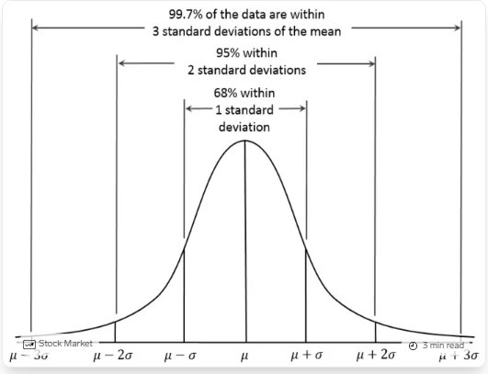
Measures of Variability: Standard Deviation
It's the square root of the variance and provides a more interpretable metric of how far individual data points deviate from the mean (average) of the dataset
The standard deviation is expressed in the same units as the original data, making it easier to relate to the scale of the dataset.
Notes:
Image source: https://www.businessinsider.in/heres-what-statisticians-mean-by-a-standard-deviation/articleshow/45353386.cms
In statistics, the "standard deviation" is a measure of the dispersion or spread of a set of values in a dataset. It's the square root of the variance and provides a more interpretable metric of how far individual data points deviate from the mean (average) of the dataset.
The standard deviation is expressed in the same units as the original data, making it easier to relate to the scale of the dataset. A higher standard deviation indicates that the data points are more spread out from the mean, while a lower standard deviation indicates that the data points are closer to the mean.
Mathematically, the population standard deviation (often denoted as "σ") is calculated as the square root of the population variance:
Population Standard Deviation (σ) = √(Population Variance)
For a sample, the sample standard deviation (often denoted as "s") is calculated as the square root of the sample variance:
Sample Standard Deviation (s) = √(Sample Variance)
When you have normally distributed data, or approximately so, the standard deviation becomes particularly valuable. You can use it to determine the proportion of the values that fall within a specified number of standard deviations from the mean. For example, in a normal distribution, 68% of the values will fall within +/- 1 standard deviation from the mean. This property is part of the Empirical Rule. This rule describes the percentage of the data that fall within specific numbers of standard deviations from the mean for bell-shaped curves.
Example: Calculating Standard Deviation of Investment Returns
Suppose you are a risk analyst evaluating the monthly returns of a stock over the past eight months to assess its volatility and risk. You have the following monthly return data (in percentage):
Monthly Returns (%): 1.2, -0.5, 2.1, -1.8, 0.9, 1.5, -0.3, 1.7
Calculate the Mean Return:
Calculate the mean return by summing up the monthly returns and dividing by the number of months:
Mean Return = (1.2 - 0.5 + 2.1 - 1.8 + 0.9 + 1.5 - 0.3 + 1.7) / 8 = 0.6375%
Calculate the Squared Deviations from the Mean:
For each month, subtract the mean return from the individual monthly return and square the result to get the squared deviations:
Squared Deviation from Mean for Month 1: (1.2 - 0.6375)² ≈ 0.3613 Squared Deviation from Mean for Month 2: (-0.5 - 0.6375)² ≈ 0.0188 ... and so on for the remaining months.
Calculate the Variance:
Calculate the variance by summing up the squared deviations and dividing by the number of months:
Variance = (0.3613 + 0.0188 + ... + [remaining squared deviations]) / 8
Calculate the Standard Deviation:
Calculate the standard deviation by taking the square root of the variance:
Standard Deviation = √(Variance)
Interpretation:
The standard deviation quantifies the average distance between each monthly return and the mean return. A higher standard deviation indicates greater volatility or spread in returns, while a lower standard deviation suggests less volatility.
In this example, calculating the standard deviation helps you understand the risk or volatility of the stock's returns over the eight-month period. It provides a measure of risk that's easier to interpret since it's expressed in the same units as the original data.

Slide 5
Standard deviation versus Variance
Variance quantifies the dispersion of data points from the mean
Variance is expressed in the original units squared, which can be challenging to interpret directly
In finance, variance is often used as a preliminary step to calculate standard deviation
Standard deviation measures the average distance of data points from the mean
It is widely used in finance to assess risk, volatility, and variability in investment returns and prices due to its unit consistency and ease of interpretation
Notes:
Suppose you are analyzing the monthly returns of two investment portfolios, A and B, over the past year:
Portfolio A: Returns of 2%, -1%, 3%, -2%, 1%
Portfolio B: Returns of 5%, -5%, 7%, -7%, 3%
Calculate Variance:
Portfolio A: Variance = 3.3
Portfolio B: Variance = 20.8
Calculate Standard Deviation:
Portfolio A: Standard Deviation ≈ √3.3 ≈ 1.82
Portfolio B: Standard Deviation ≈ √20.8 ≈ 4.56
In this example, both portfolios have higher variability (risk) in Portfolio B compared to Portfolio A. The variance provides a quantitative measure of this variability, while the standard deviation offers a more intuitive interpretation of the risk level.
In finance, standard deviation is often preferred due to its easier interpretation and unit consistency. It provides a clearer understanding of the variability in investment returns, making it a crucial tool for risk assessment and portfolio management.

Slide 6
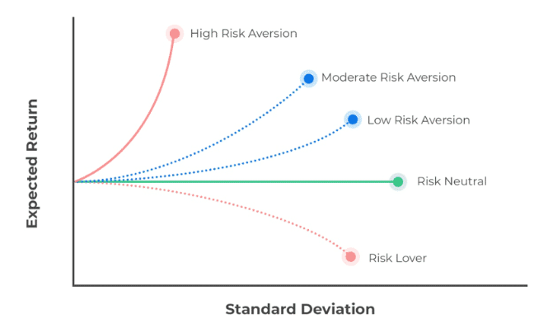
Mean-Variance Framework
The Mean-Variance Framework is a cornerstone concept in modern portfolio theory (MPT)
The main idea is to construct portfolios that maximize expected return while minimizing portfolio risk
The framework encourages diversification by combining assets with different risk-return profiles
Notes:
Image Source: https://analystprep.com/study-notes/actuarial-exams/soa/ifm-investment-and-financial-markets/mean-variance-portfolio-theory/
The Mean-Variance Framework is a cornerstone concept in modern portfolio theory (MPT), a theory developed by Harry Markowitz in the 1950s that revolutionized the way investors approach portfolio construction and risk management. The framework provides a systematic approach to optimizing investment portfolios based on the trade-off between expected return and risk.
The Mean-Variance Framework involves two key components: the mean (expected return) and the variance (or standard deviation, a measure of risk) of a portfolio. The main idea is to construct portfolios that maximize expected return while minimizing portfolio risk. This framework considers diversification as a means to achieve this optimization.
Here's how the Mean-Variance Framework works:
Expected Return: Each asset in a portfolio has an expected return, representing the average return it is expected to yield over a specific period.
Risk: The risk of an asset is measured by its variance or standard deviation. Assets with higher variances or standard deviations are considered riskier.
Covariance and Correlation: The framework also takes into account the relationships between the returns of different assets, represented by their covariances or correlations. Assets that move in the opposite direction (negative correlation) can reduce overall portfolio risk when combined.
Efficient Frontier: The efficient frontier is a curve that represents the set of portfolios that offer the maximum return for a given level of risk, or the minimum risk for a given level of return. The Mean-Variance Framework aims to identify the optimal mix of assets that lie on this efficient frontier.
Optimization: The goal is to find the allocation of assets that maximizes expected return while minimizing portfolio risk. This is achieved by considering the trade-off between risk and return for various portfolio combinations.
Diversification: The framework encourages diversification by combining assets with different risk-return profiles. Diversification can reduce overall portfolio risk without necessarily sacrificing expected return.
Investors use the Mean-Variance Framework to construct portfolios that align with their risk tolerance and investment goals. By selecting assets with different risk and return characteristics and combining them in an optimal way, investors can build portfolios that offer a balance between risk and potential reward. The framework also provides insights into how changes in asset allocation can impact the risk and return of a portfolio.

Slide 7
Limitations of Mean-Variance Framework
The framework assumes that asset returns follow a normal distribution
The framework is based on single-period analysis
The framework relies heavily on the second moments (variance and covariance) of asset returns, it does not capture higher moments such as skewness and kurtosis
The framework assumes linear relationships between asset returns and portfolio returns
The framework does not incorporate transaction costs, taxes, and other market frictions
Notes:
While the Mean-Variance Framework is a foundational concept in modern portfolio theory and has greatly contributed to portfolio management, it also comes with certain limitations and assumptions that may affect its practical applicability. Here are some key limitations of the Mean-Variance Framework:
Assumption of Normality: The framework assumes that asset returns follow a normal distribution. However, in reality, financial markets are known to exhibit characteristics such as fat tails and skewness, which can lead to significant deviations from normality. This can result in inaccurate risk and return estimates.
Single-Period Analysis: The framework is based on single-period analysis, which does not consider changing economic conditions or market dynamics over time. In reality, investment decisions are made over multiple periods, and market conditions can vary.
Focus on Second Moments: The framework relies heavily on the second moments (variance and covariance) of asset returns. It does not capture higher moments such as skewness and kurtosis, which are important for assessing non-normality and extreme events.
4.Linear Relationship Assumption: The framework assumes linear relationships between asset returns and portfolio returns. In reality, nonlinear relationships can occur, particularly during extreme market conditions.
5.No Consideration of Transaction Costs: The framework does not incorporate transaction costs, taxes, and other market frictions that can impact portfolio performance. Ignoring these costs can result in unrealistic portfolio recommendations.

Slide 8
Beta

Slide 9
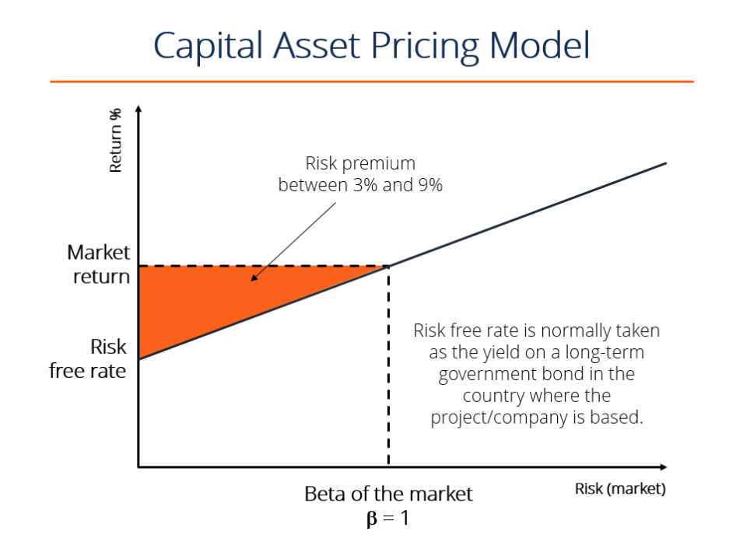
Capital Asset Pricing Model
A model used in investment analysis and decision-making
To estimate the expected return of an asset based on its risk (β) relative to the overall market
Assumes that investors are rational, risk-averse, and diversify their portfolios
Notes:
Image Source: https://theintactone.com/2019/01/08/sfm-u1-topic-7-portfolio-tools-capital-asset-pricing-model/
Capital Asset Pricing Model:
The Capital Asset Pricing Model (CAPM) is a widely used financial model that helps investors and analysts estimate the expected return of an investment by considering its risk in relation to the overall market. CAPM is used to determine the appropriate rate of return an investor should demand for holding a particular asset, given its risk profile and the risk-free rate of return available in the market.
3
The CAPM is based on the following key concepts:
Expected Return: The CAPM calculates the expected return of an asset based on the risk-free rate of return, the asset's beta (a measure of its risk compared to the overall market), and the market risk premium (the excess return expected from the market over the risk-free rate).
Risk-Free Rate: The risk-free rate is the theoretical rate of return on an investment with zero risk, typically represented by the yield on government bonds or Treasury bills.
Market Risk Premium: The market risk premium represents the excess return that investors demand for taking on the additional risk of investing in the overall market compared to a risk-free investment. It's the difference between the expected market return and the risk-free rate.
Beta: Beta measures the sensitivity of an asset's returns to fluctuations in the market. An asset with a beta of 1 moves in line with the market. A beta greater than 1 indicates higher volatility than the market, and a beta less than 1 indicates lower volatility.
The CAPM formula is as follows:
Expected Return (E(Ri)) = Risk-Free Rate + Beta (E(Rm) - Risk-Free Rate)
Where:
E(Ri) = Expected return of the asset
Risk-Free Rate = Risk-free rate of return
Beta = Beta of the asset
E(Rm) = Expected market return

Slide 10

CAPM is widely used in investment decision-making and portfolio management
Risk and Return Trade-off
Cost of Capital
Portfolio Management
Setting Investment Expectations
Valuation
Notes:
Image source: https://www.investopedia.com/terms/i/international-capm.asp
The CAPM is widely used in investment decision-making and portfolio management for several reasons:
Risk and Return Tradeoff: CAPM provides a systematic way to evaluate an investment's expected return relative to its risk. Investors can compare different investments and assess whether the potential return justifies the associated risk.
Cost of Capital: CAPM is used by companies to determine their cost of equity capital, which is required when evaluating new investment projects or making capital allocation decisions.
Portfolio Management: CAPM helps investors construct well-diversified portfolios that maximize returns for a given level of risk. By selecting assets with different betas, investors can achieve an optimal balance between risk and return.
Setting Investment Expectations: Investors can use CAPM to set realistic expectations for the returns they can achieve based on the risk they are willing to take on.
Valuation: CAPM is used in the valuation of companies and assets. By estimating the cost of equity using CAPM, analysts can determine the required rate of return when valuing companies using discounted cash flow (DCF) analysis.
It's important to note that while the CAPM provides a useful framework, it has limitations and assumptions that may not always hold in real-world situations. Critics argue that the model oversimplifies market dynamics, assumes linear relationships, and relies on past data to predict future returns. Despite its limitations, CAPM remains a valuable tool in the realm of finance and investment analysis.
EMH versus CAPM:
The Efficient Market Hypothesis (EMH) and the Capital Asset Pricing Model (CAPM) are both fundamental concepts in finance, but they address different aspects of investment and market behavior. Here's a comparison between the two:
1. Focus:
Efficient Market Hypothesis (EMH): EMH primarily focuses on the efficiency of financial markets. It suggests that market prices quickly and accurately reflect all available information, making it difficult to consistently outperform the market by trading on public information.
Capital Asset Pricing Model (CAPM): CAPM is a model used to estimate the expected return of an asset based on its risk relative to the overall market. It provides a framework for determining the appropriate rate of return an investor should expect given the asset's risk and the market's risk and return characteristics.
2. Main Concepts:
EMH: The three forms of EMH (weak, semi-strong, and strong) emphasize the degree to which different types of information (historical prices, public information, and all information including insider information) are already reflected in market prices.
CAPM: CAPM focuses on the relationship between an asset's risk (measured by beta) and its expected return. It combines the risk-free rate, market risk premium, and the asset's beta to estimate its expected return.
3. Implications:
EMH: EMH implies that it's challenging to consistently earn abnormal returns (excess returns beyond what would be expected from risk) through active trading strategies. Investors are more likely to achieve market returns, and any outperformance is due to luck rather than skill.
CAPM: CAPM implies that an asset's expected return should be commensurate with its level of risk. Assets with higher beta should offer higher expected returns to compensate for the additional market risk they bring to a portfolio.
4. Application:
EMH: EMH is more of a theory that provides insight into market behavior. It helps investors understand that information dissemination in efficient markets happens rapidly and that it's challenging to identify mispriced assets based on public information.
CAPM: CAPM is a quantitative model used in investment analysis and decision-making. It aids in estimating an appropriate required rate of return for an asset, facilitating investment selection and portfolio construction.
5. Assumptions:
EMH: EMH assumes rational investors who process information efficiently, no transaction costs, and a large number of market participants competing to incorporate new information into prices.
CAPM: CAPM assumes that investors are rational, risk-averse, and diversify their portfolios. It also assumes frictionless markets without taxes or transaction costs.
6. Relation:
Relation Between EMH and CAPM: CAPM can be considered an application of EMH in the sense that it estimates the expected return that investors demand based on the risk associated with an asset. CAPM assumes that investors make investment decisions based on market efficiency principles.
In summary, while both EMH and CAPM are important concepts in finance, they address different aspects of investment theory. EMH provides insights into market efficiency, while CAPM is a quantitative model used to estimate expected returns based on an asset's risk and market dynamics.

Slide 11
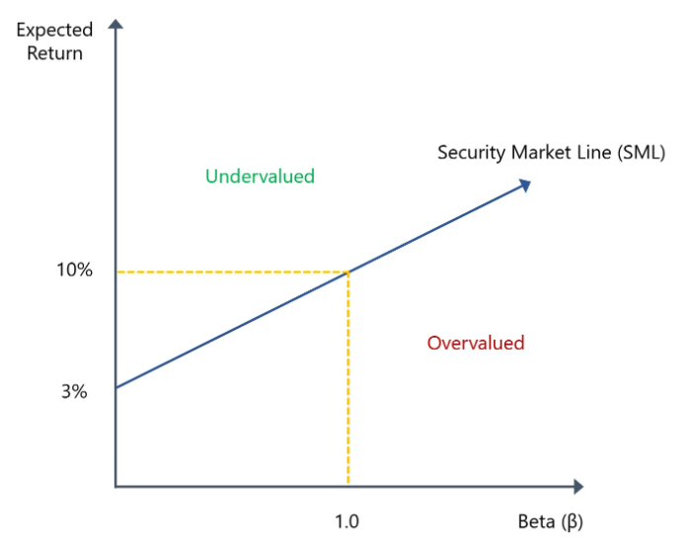
Securities Market Line
Graphical representation of the capital asset pricing model
To determine whether an asset is overpriced or underpriced, given its level of systematic risk, compared to the market
Used by money managers and investors to evaluate an investment product that they're thinking of including in a portfolio
Notes:
Image source: https://www.wallstreetprep.com/knowledge/security-market-line-sml/
Securities Market Line:
The security market line (SML) is a line drawn on a chart that serves as a graphical representation of the capital asset pricing model (CAPM)—which shows different levels of systematic, or market risk, of various marketable securities, plotted against the expected return of the entire market at any given time.
Security Market Line = Risk-Free Rate + [Beta * (Expected Market Return – Risk-Free Rate)]
Plotting the function for all positive betas, with the constraint of a positive market risk premium (Expected Market Return – Risk-Free Rate), will give the typical security market line. To get the expected risk premium of a security, subtract the first risk-free rate from both sides of the equation. It will produce:
Expected Security Risk Premium = Beta * (Expected Market Return – Risk-Free Rate)
The security market line is commonly used by money managers and investors to evaluate an investment product that they're thinking of including in a portfolio. The SML is useful in determining whether the security offers a favorable expected return compared to its level of risk.
The security market line is used to determine whether an asset is overpriced or underpriced, given its level of systematic risk, compared to the market. Graphically, if the asset offers a return that is higher than the market’s for a given level of systematic risk, it will be plotted above the security market line. However, if the asset offers a return that is lower than the market’s for a given level of systematic risk, it will be plotted below the security market line.
If an asset is plotted above the security market line, it is underpriced. If an asset is plotted below, it is overpriced. The intuitive reason why an asset that is plotted above the SML is underpriced is that it is giving a return larger than the market, and it is because the cost of buying the asset is not large enough. The return of an asset is directly related to the price at which the asset is bought. Thus, with the security market line, if an asset is providing too large of a return, it means that it is underpriced.
The same intuition holds for when an asset is overpriced. The price of the asset is too high, which eats away at the returns the asset provides and thus, causes the asset to be plotted below the security market line. The assets that are plotted above the SML are bought, which increases the demand and the price of the asset, thus decreasing its expected return and bringing it back down to the security market line. The same goes for assets plotted below the SML.

Slide 12
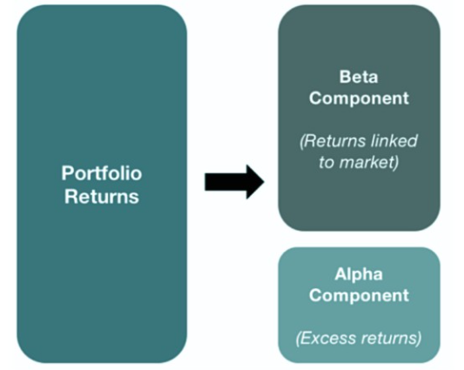
Beta and Alpha
Beta is a measure of an investment's sensitivity to overall market movements
Alpha represents the excess return an investment generates beyond what would be predicted by its beta and the market risk premium.
Beta helps to assess an investment's risk and potential volatility, while alpha helps determine whether an investment has added value beyond what would be expected given its risk exposure
Notes:
Image source: https://www.wallstreetmojo.com/alpha-in-finance/
Beta and Alpha:
In the context of financial markets, beta and alpha are two important concepts used to assess the risk and return characteristics of investments and portfolios. They are used to evaluate how an investment performs relative to the market and the risk-free rate. Let's delve into what beta and alpha mean:
Beta (β): Beta is a measure of an investment's sensitivity to overall market movements. It quantifies the extent to which an investment's returns move in relation to the returns of the overall market. A beta of 1 indicates that the investment's returns move in line with the market, while a beta greater than 1 indicates higher volatility compared to the market, and a beta less than 1 indicates lower volatility.
Interpretation:
β = 1: Investment's volatility matches that of the market.
β > 1: Investment is more volatile than the market.
β < 1: Investment is less volatile than the market.
Example:
If an investment has a beta of 1.2, it is expected to move approximately 20% more than the market in either direction (up or down). On the other hand, if an investment has a beta of 0.8, it is expected to be less volatile than the market.
Alpha (α): Alpha is a measure of an investment's performance relative to its expected return based on its systematic risk (beta). It represents the excess return an investment generates beyond what would be predicted by its beta and the market risk premium. Positive alpha indicates that an investment outperformed its expected return given its level of risk, while negative alpha suggests underperformance.
Interpretation:
α > 0: Investment has outperformed expectations, generating excess return.
α < 0: Investment has underperformed expectations, generating lower return than expected.
Example:
If an investment's expected return, based on its beta and the market risk premium, is 8%, but it actually returns 9%, then it has a positive alpha of 1%, indicating that it outperformed its expected return.
Beta and Alpha in CAPM: In the context of CAPM, beta is used to estimate an investment's expected return, while alpha is used to assess how well the investment performed relative to that expected return. An investment's expected return according to CAPM is given by the formula:
Expected Return (E(Ri)) = Risk-Free Rate + Beta (Market Risk Premium)
An investment's actual return minus its expected return (adjusted for its beta and the market risk premium) gives its alpha.
Beta and alpha play crucial roles in portfolio management, investment analysis, and performance evaluation. Investors use beta to assess an investment's risk and potential volatility, while alpha helps determine whether an investment has added value beyond what would be expected given its risk exposure.

Slide 13
Value at Risk and Expected Shortfall

Slide 14
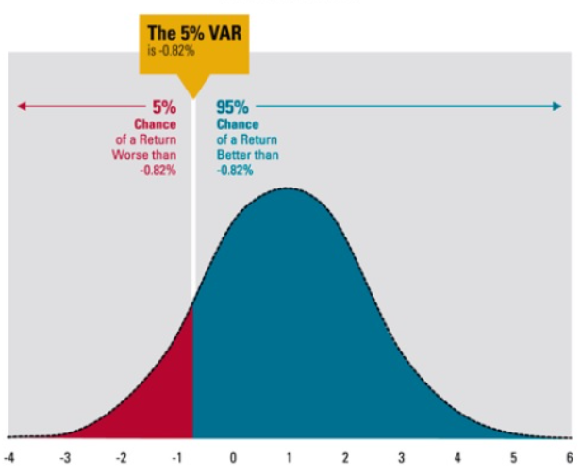
Introduction to Value at Risk (VaR)
VaR estimates the maximum amount a portfolio's value could decline within a given time frame, under normal market conditions, with a certain level of probability
VaR is typically expressed as a monetary value or a percentage of the portfolio's initial value
For example, a 1-day VaR of USD 1 million at a 95% confidence level means that there is a 5% chance that the portfolio will lose more than USD 1 million in value over the next day
Notes:
Image source: https://wikibanks.cz/value-at-risk-var/
Value at Risk (VaR) is a widely used risk management metric in banks and financial institutions that quantifies the potential loss in the value of a portfolio or investment over a specified time horizon and at a certain level of confidence. In other words, VaR estimates the maximum amount a portfolio's value could decline within a given time frame, under normal market conditions, with a certain level of probability.
VaR is typically expressed as a monetary value or a percentage of the portfolio's initial value. For example, a 1-day VaR of INR 1 million at a 95% confidence level means that there is a 5% chance that the portfolio will lose more than INR 1 million in value over the next day or the maximum loss would be INR 1 million the next day with 95% probability.
Components of VaR:
Time Horizon: VaR is calculated for a specific time frame, such as one day, one week, or one month. The time horizon influences the potential losses that can occur.
Confidence Level: The confidence level represents the probability that the actual loss will not exceed the calculated VaR. For example, a 95% confidence level means that the loss is expected to stay within the VaR value 95% of the time.
Portfolio Value: VaR is calculated based on the current value of the portfolio or investment.

Slide 15
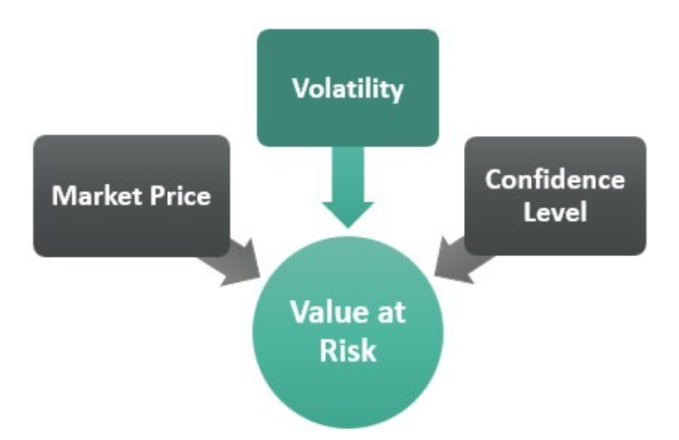
Calculation of VaR
There are several methods to calculate VaR, including historical simulation, parametric methods, and Monte Carlo simulation
Here's a brief overview of the parametric method:
VaR=Portfolio Value* Z-Score * Portfolio Std. Dev
Where the Z-Score corresponds to the critical value associated with the desired confidence level. For example, for a 95% confidence level, the Z-Score might be approximately 1.65
Notes:
Image source: https://www.wallstreetmojo.com/value-at-risk/
Applications of VaR in Banks:
Risk Management: VaR helps banks assess the potential downside risk of their portfolios and investment positions. It's a key tool in identifying and quantifying the level of risk exposure in their trading and investment activities.
Capital Allocation: Banks allocate capital based on the risk profiles of their portfolios. VaR assists in determining the amount of capital that should be set aside to cover potential losses within a specified confidence level.
Stress Testing: VaR is used in stress testing to assess the impact of extreme market events on portfolios. By calculating VaR under different stress scenarios, banks can gauge the resilience of their portfolios to adverse conditions.
Regulatory Compliance: Regulatory bodies often require financial institutions to measure and report their risk exposure. VaR is a standard metric used in regulatory reporting to demonstrate the adequacy of risk management practices.
Investment Decision-Making: VaR informs investment decisions by providing insights into the potential risks associated with different assets or strategies. It helps banks strike a balance between risk and potential return.
Hedging and Risk Mitigation: Banks use VaR to design hedging strategies to manage risk exposure effectively. By understanding potential losses, they can hedge against adverse market movements.
Performance Evaluation: VaR is used to evaluate the performance of trading desks and portfolio managers. It helps measure the effectiveness of risk management practices.
While VaR is a valuable risk management tool, it's important to note that it has limitations, such as its reliance on historical data and its assumption of normal distribution. As a result, VaR should be used in conjunction with other risk management techniques to provide a comprehensive understanding of portfolio risk.

Slide 16
Normal VaR and Log-normal VaR
Normal VaR (Value at Risk) and log-normal VaR are two different approaches to estimating the potential losses of a portfolio or investment
They assume that returns are stationary, independent, and identically distributed
If the returns distribution is approximately symmetric and follows a normal distribution, Normal VaR can provide a reasonable estimate of potential losses. However, if the returns distribution is skewed or exhibits fat tails, meaning it has a higher probability of extreme returns, log-normal VaR may be more appropriate
Notes:
Normal VaR (Value at Risk) and log-normal VaR are two different approaches to estimating the potential losses or downside risk of a portfolio or investment using different assumptions about the underlying distribution of returns.
Normal VaR: Normal VaR assumes that the returns of the portfolio or investment follow a normal distribution. In a normal distribution, the data is symmetrically distributed around the mean, and the probability of extreme events is relatively low. When calculating Normal VaR, the mean and standard deviation of the returns are used to estimate the potential loss at a given confidence level. The Normal VaR provides an estimate of the maximum loss that can be expected with a certain level of confidence.
Log-normal VaR assumes that the logarithmic returns of the portfolio or investment follow a normal distribution. Logarithmic returns are often used because they have the property of being additive over time, which simplifies calculations and modeling. Log-normal distributions are skewed to the right, meaning they have a longer right tail and can accommodate a wider range of positive returns. When calculating Log-normal VaR, the mean and standard deviation of the logarithmic returns are used to estimate the potential loss at a given confidence level.
The choice between Normal VaR and log-normal VaR depends on the characteristics of the returns distribution. If the returns distribution is approximately symmetric and follows a normal distribution, Normal VaR can provide a reasonable estimate of potential losses. However, if the returns distribution is skewed or exhibits fat tails, meaning it has a higher probability of extreme returns, log-normal VaR may be more appropriate as it captures the distribution's asymmetry and potential for large positive or negative returns.
Example:Let's consider a hypothetical investment portfolio and calculate Normal VaR and log-normal VaR using numerical examples:
Normal VaR: Assume we have a portfolio with a mean return of 0.05 (5%) and a standard deviation of 0.10 (10%). We want to calculate the one-day 95% Normal VaR, which represents the potential loss at a 95% confidence level.
To calculate Normal VaR, we use the formula: Normal VaR = Mean Return - (Z-Score * Standard Deviation)
Given a confidence level of 95%, the corresponding Z-score is approximately 1.645.
Normal VaR = 0.05 - (1.645 * 0.10) = 0.05 - 0.1645 = -0.1145 or -11.45%
This means that there is a 5% chance of experiencing a one-day loss of 11.45% or more in the portfolio based on the assumption of a normal distribution of returns.
Log-normal VaR: Assuming the logarithmic returns of the portfolio are normally distributed, we can calculate the log-normal VaR.
Using the same portfolio example, let's assume the mean logarithmic return is 0.04 (4%) and the standard deviation of logarithmic returns is 0.08 (8%). We want to calculate the one-day 95% log-normal VaR.
To calculate log-normal VaR, we use the formula: Log-normal VaR = Portfolio Value * (1 - e^(Mean Log Return - (Z-Score * Standard Deviation)))
Let's assume the portfolio value is USD1,000,000.
Given a confidence level of 95%, the corresponding Z-score is approximately 1.645.
Log-normal VaR = USD 1,000,000 * (1 - e^(0.04 - (1.645 * 0.08)))
=USD 1,000,000 * (1 - e^(0.04 - 0.1316))
=USD 1,000,000 * (1 - e^(-0.0916))
=USD 1,000,000 * (1 - 0.9123)
=USD 87,770
This means that there is a 5% chance of experiencing a one-day loss of approximately USD 87,770 or more in the portfolio based on the assumption of a log-normal distribution of logarithmic returns.

Slide 17
Linear Combinations of Normally Distributed Variables
When combining normal random variables linearly, the resulting variable is also normally distributed
The property of linear combinations of normally distributed variables following a normal distribution is a key result derived from already discussed central limit theorem
Linear combinations of normally distributed variables have significant applications in finance. For example, in portfolio theory, the return on a portfolio can be expressed as a linear combination of the returns of its individual assets
Notes:
Linear combinations of normally distributed variables refer to the mathematical combination of two or more random variables that follow a normal distribution. When combining normal random variables linearly, the resulting variable is also normally distributed.
More specifically, if X1, X2, ..., X_{n} are independent normally distributed random variables with means μ1, μ2, ..., μ_{n} and standard deviations σ1, σ2, ..., σ_{n}, respectively, and if a1, a2, ..., a_{n} are constants, then the linear combination Y = a1X1 + a2X2 + ... + a_{n}X_{n} follows a normal distribution.
The mean of the linear combination is given by: E(Y) = a1μ1 + a2μ2 + ... + a_{n}μ_{n}
The variance of the linear combination is given by: Var(Y) = (a1^2)σ1^2 + (a2^2)σ2^2 + ... + (a_{n}^2)σ_{n}^2
If the linear combination is a weighted sum of normally distributed variables, the resulting variable will still follow a normal distribution.
Linear combinations of normally distributed variables have significant applications in finance. For example, in portfolio theory, the return on a portfolio can be expressed as a linear combination of the returns of its individual assets. The normality assumption allows for mathematical analysis and statistical inference regarding the portfolio's overall risk and expected return.
The property of linear combinations of normally distributed variables following a normal distribution is a key result derived from already discussed central limit theorem. This theorem states that under certain conditions, the sum or average of a large number of independent and identically distributed random variables tends to have an approximately normal distribution, even if the original variables are not normally distributed.
Let's consider a numerical example to illustrate linear combinations of normally distributed variables.
Suppose we have two stocks, Stock A and Stock B, with normally distributed daily returns. Stock A has a mean return of 0.02 (2%) and a standard deviation of 0.05 (5%), while Stock B has a mean return of 0.01 (1%) and a standard deviation of 0.03 (3%). We want to calculate the mean and standard deviation of a portfolio that combines these two stocks with certain weights.
Let's assume we invest 60% in Stock A and 40% in Stock B. We will calculate the mean and standard deviation of the portfolio return using the concept of linear combinations.
Mean of the Portfolio Return: Mean of the portfolio return (μp) is given by the weighted sum of the individual stock returns: μp = (Weight of Stock A * Mean of Stock A) + (Weight of Stock B * Mean of Stock B) = (0.6 * 0.02) + (0.4 * 0.01) = 0.012 + 0.004 = 0.016 or 1.6%
Standard Deviation of the Portfolio Return: To calculate the standard deviation of the portfolio return, we need to consider the covariance between the stock returns as well. Assuming the covariance between Stock A and Stock B is 0.0015:
Variance of the portfolio return (σp^2) is given by the weighted sum of the variances and covariances: σp^2 = (Weight of Stock A)^2 * Variance of Stock A + (Weight of Stock B)^2 * Variance of Stock B + 2 * Weight of Stock A * Weight of Stock B * Covariance(Stock A, Stock B) = (0.6)^2 * 0.05^2 + (0.4)^2 * 0.03^2 + 2 * 0.6 * 0.4 * 0.05 * 0.03 = 0.0018 + 0.00072 + 0.000036 = 0.002556
Standard deviation of the portfolio return (σp) is the square root of the variance: σp = √(0.002556) ≈ 0.0506 or 5.06%
So, the portfolio with 60% invested in Stock A and 40% invested in Stock B has an expected return of 1.6% and a standard deviation of 5.06%.
This example demonstrates how linear combinations of normally distributed variables (stock returns) can be used to calculate the mean and standard deviation of a portfolio return in finance. By combining stocks with different weights, we can determine the risk and return characteristics of the overall portfolio.

Slide 18
Joint Probability Distribution and Portfolio VaR
Joint Probability Distribution plays a critical role in Portfolio Value at Risk (VaR) analysis by helping to assess the risk of a multi-asset portfolio
To build the joint probability distribution, you typically start by estimating the covariance matrix among the assets in the portfolio
Using the covariance matrix, a multivariate probability distribution is specified that characterizes the joint distribution of returns for all assets in the portfolio
Notes:
Joint Probability Distribution plays a critical role in Portfolio Value at Risk (VaR) analysis by helping to assess the risk of a multi-asset portfolio. Here's how it's used in Portfolio VaR:
Understanding Asset Interactions: In a portfolio with multiple assets, the joint probability distribution allows you to model and understand how these assets interact with each other. Specifically, it helps you capture the dependencies, correlations, or covariances between the returns of different assets. These interactions are crucial because they influence the overall risk of the portfolio.
Correlation or Covariance Matrix: To build the joint probability distribution, you typically start by estimating the correlation or covariance matrix among the assets in the portfolio. This matrix quantifies the degree to which asset returns move together (positive correlation) or move in opposite directions (negative correlation). It provides essential information about the co-movements of assets, which is necessary for modeling portfolio risk.
Multivariate Distribution: Using the correlation or covariance matrix, you can specify a multivariate probability distribution that characterizes the joint distribution of returns for all assets in the portfolio. Common choices include the multivariate normal distribution or more complex models that capture non-normality and tail dependence.
Simulation Techniques: Portfolio VaR often involves running simulations to estimate the distribution of the portfolio's value at the end of the chosen time horizon. Monte Carlo simulation is a widely used method for this purpose. In these simulations, you draw random samples from the specified multivariate distribution to generate possible scenarios for asset returns.
Portfolio Construction: For each simulation scenario, you construct the portfolio by applying the specified asset weights to the simulated returns. This results in a distribution of portfolio values at the end of the time horizon for each scenario.
VaR Calculation: After running a large number of simulations, you have a distribution of portfolio values. To calculate Portfolio VaR, you identify the appropriate quantile of this distribution at a specified confidence level (e.g., 95% or 99%). The value at this quantile represents the potential loss of the portfolio over the chosen time horizon with the specified confidence.
Let's consider a simplified numerical example to demonstrate the usage of Joint Probability Distribution in Portfolio Value at Risk (VaR) analysis. In this example, we'll have a portfolio consisting of two assets: Stock A and Stock B.
Step 1: Asset Data
Let's assume we have the following historical data for the daily returns of Stock A and Stock B for the past 100 trading days:
Stock A returns follow a normal distribution with a mean (μA) of 0.0012 (0.12%) and a standard deviation (σA) of 0.02 (2%).
Stock B returns follow a normal distribution with a mean (μB) of 0.0008 (0.08%) and a standard deviation (σB) of 0.015 (1.5%).
Step 2: Portfolio Construction
We construct a portfolio with the following weights:
Weight of Stock A (WA) = 0.6 (60%)
Weight of Stock B (WB) = 0.4 (40%)
Step 3: Correlation Coefficient
The correlation coefficient between Stock A and Stock B returns is estimated to be ρ = 0.4 (positive correlation).
Step 4: Joint Probability Distribution
Now, we need to create the joint probability distribution to simulate portfolio returns. We will assume a bivariate normal distribution to model the joint distribution of returns for Stock A and Stock B, taking into account the correlation coefficient:
μA and μB are the means of the individual returns.
σA and σB are the standard deviations of the individual returns.
ρ is the correlation coefficient.
ρAB = ρAσAσB is the covariance between Stock A and Stock B.
Using these parameters, we can specify the bivariate normal distribution.
Step 5: Monte Carlo Simulation
We'll use Monte Carlo simulation to generate a large number of random scenarios for Stock A and Stock B returns, considering the joint probability distribution. For each scenario, we calculate the portfolio return using the specified weights:
Portfolio Return (R_Portfolio) = WA * R_A + WB * R_B
Where R_A and R_B are the simulated returns for Stock A and Stock B, respectively.
Step 6: Portfolio VaR Calculation
After running thousands of simulations, we have a distribution of portfolio returns. To calculate the Portfolio VaR at a 95% confidence level, we sort the portfolio returns and identify the value below which the worst 5% of returns fall.
Let's assume that the 5th percentile of the portfolio return distribution corresponds to a loss of -1.5%. This means that there is a 5% chance of the portfolio experiencing a loss greater than or equal to -1.5% over the specified time horizon.
The Portfolio VaR of -1.5% at a 95% confidence level indicates that there is a 5% probability that the portfolio will incur a loss of at least 1.5% over the specified time horizon. This risk assessment takes into account the joint distribution of returns for both assets and the specified correlation between them.

Slide 19
Coherence of Risk Measures
The coherence of risk measures refers to a set of desirable properties that risk measures should possess
Monotonicity states that higher levels of risk should result in higher measure values
Subadditivity means that the risk measure of a combined portfolio should be less than or equal to the sum of the risk measures of its individual components
Translation invariance states that adding a constant amount to all positions in a portfolio should not change the risk measure value
Positive homogeneity means that multiplying the portfolio by a positive constant should also multiply the risk measure by the same constant
Notes:
The coherence of risk measures refers to a set of desirable properties that risk measures should possess. These properties ensure that risk measures behave consistently and intuitively when assessing and comparing different risk profiles or portfolios. The coherence properties provide a framework for evaluating the quality and usefulness of risk measures in risk management and decision-making processes.
The key coherence properties of risk measures are as follows:
Monotonicity states that higher levels of risk should result in higher measure values. In other words, if one portfolio has a higher level of risk than another, its risk measure should also be higher. For example, if we compare two portfolios, Portfolio A and Portfolio B, and Portfolio A has a higher volatility or a larger expected loss than Portfolio B, then a coherent risk measure will assign a higher value to Portfolio A.
Subadditivity means that the risk measure of a combined portfolio should be less than or equal to the sum of the risk measures of its individual components. This property captures the diversification benefit of combining assets in a portfolio. For example, if Portfolio A has a risk measure of 10% and Portfolio B has a risk measure of 8%, the combined portfolio's risk measure should be less than 18%.
Translation invariance states that adding a constant amount to all positions in a portfolio should not change the risk measure value. For example, if we add INR 10,000 to all positions in a portfolio, the risk measure should remain the same. The risk measure should only depend on the relative proportions and risk characteristics of the assets in the portfolio, not on the overall scale.
Positive homogeneity means that multiplying the portfolio by a positive constant should also multiply the risk measure by the same constant. This property ensures that risk measures are consistent with scaling changes in the portfolio. For example, if we double the portfolio size and all the risk characteristics remain the same, the risk measure should also double.

Slide 20
Why VaR is not Coherent?
VaR does not meet the requirement of subadditivity which states that the risk measure of a combined portfolio should be less than or equal to the sum of the risk measures of its individual components
VaR does not adequately account for tail dependencies between assets, where extreme events in one asset are related to extreme events in another
Notes:
VaR does not meet the requirement of subadditivity which states that the risk measure of a combined portfolio should be less than or equal to the sum of the risk measures of its individual components. Subadditivity implies that diversifying risk across multiple assets should reduce the overall risk of a portfolio. However, VaR does not always behave this way. When using VaR to measure the risk of a portfolio, the portfolio's VaR can, in some cases, be larger than the sum of the individual VaRs of its components. This means that combining assets in a portfolio may result in higher apparent risk than holding the assets separately, which contradicts the concept of risk diversification.
VaR does not adequately account for tail dependencies between assets, where extreme events in one asset are related to extreme events in another. In situations with significant tail dependencies, combining assets can lead to increased risk, making the portfolio's VaR greater than the sum of individual VaRs.

Slide 21
Expected Shortfall
Expected Shortfall (ES), also known as Conditional Value at Risk (CVaR), is a risk measure that quantifies the average expected loss of a portfolio or investment beyond a certain VaR (Value at Risk) threshold
ES takes into account the entire tail of the distribution, providing information about the expected loss beyond the VaR threshold
ES is a coherent risk measure, meaning it satisfies a set of desirable mathematical properties such as subadditivity, convexity, and translation invariance
Notes:
Expected Shortfall (ES), also known as Conditional Value at Risk (CVaR), is a risk measure used in finance and risk management to quantify the average loss or tail risk associated with an investment or portfolio at a specified confidence level. ES provides a more comprehensive assessment of risk compared to Value at Risk (VaR) because it focuses on the expected value of losses beyond a certain threshold, rather than a single quantile of the loss distribution.
Here's a detailed explanation of Expected Shortfall (ES):
Threshold Selection: To calculate ES, you first need to choose a threshold, often denoted as α, which represents a certain confidence level. Common choices include 95%, 99%, or other confidence levels. It indicates the portion of the worst outcomes you want to consider.
Loss Distribution: Next, you analyze the historical or simulated distribution of portfolio returns or losses. This distribution typically represents the potential outcomes of an investment or portfolio over a specified time horizon.
Calculating ES: Once you have the loss distribution, ES is computed by averaging the losses that exceed the chosen threshold α. In simpler terms, ES is the expected value of losses that occur beyond the α-quantile, weighted by the probability of these losses occurring. It represents the average magnitude of losses in the tail of the distribution.
Interpretation: ES is expressed as a percentage or a dollar amount and represents the expected loss in a given portfolio or investment when losses exceed the chosen confidence level. For example, if you calculate a 95% ES of -3%, it means that, on average, you can expect a loss of 3% or more when the portfolio is in the worst 5% of possible outcomes.
Risk Assessment: ES is particularly valuable for assessing tail risk and capturing the potential severity of losses during extreme market conditions. It is often used in risk management to make informed decisions about capital allocation, risk mitigation strategies, and portfolio diversification.
Coherence: ES is considered a coherent risk measure because it satisfies key coherence properties, including subadditivity, homogeneity, and monotonicity. These properties make ES a robust and consistent measure for comparing and managing risk across different portfolios and asset classes.

Slide 22
Machine Learning Approach to Risk Measurement
Advanced Modelling
Non-Normal Distributions
High-Dimensional Data
Time Series Forecasting
Tail Risk Analysis
Portfolio Optimization
Dynamic VaR
News and Sentiment Analysis
Notes:
Advanced Modeling: Machine learning allows for more complex and flexible models to estimate VaR. Traditional methods like parametric (e.g., normal distribution) and historical (e.g., using past data) approaches have limitations, while machine learning can handle non-linear relationships and capture intricate patterns in financial data.
Non-Normal Distributions: Financial data often does not follow a normal distribution. Machine learning can work with different distributional assumptions, including heavy-tailed distributions such as the Student's t-distribution, which is more appropriate for capturing extreme events.
High-Dimensional Data: Financial markets generate vast amounts of data. Machine learning techniques like neural networks and support vector machines can handle high-dimensional data efficiently, which is beneficial for risk modeling when considering a wide range of assets.
Time Series Forecasting: Machine learning models, such as recurrent neural networks (RNNs) and long short-term memory networks (LSTMs), are capable of time series forecasting. These models can capture the temporal dependencies in financial data, making them suitable for predicting future asset prices and estimating VaR.
Tail Risk Analysis: Machine learning can help in better quantifying tail risk, which is essential in VaR assessments. Techniques like extreme value theory (EVT) can be combined with machine learning to model and predict extreme events more accurately.
Portfolio Optimization: Machine learning can optimize portfolio allocation strategies to minimize VaR while achieving desired returns. Reinforcement learning, for instance, can help in adaptive portfolio management.
Dynamic VaR: Machine learning models can provide dynamic VaR estimates, which adjust continuously based on the most recent data. This is particularly important for real-time risk management.
News and Sentiment Analysis: Natural language processing (NLP) techniques can process news articles and sentiment data to assess how news and market sentiment impact asset prices. This information can be integrated into VaR models to account for external events.

